Slide 1

Talend ESB
Module Code : ESB03
By : Muhammad Faris Ashim

Slide 2
Agenda
Describe the structure of a message
Describe the structure of an exchange
Use the SIMPLE language in a mediation route
Access message elements with Java code
Send a message from one route to another
Use the cDirect component as a producer and consumer

Slide 3


Talend ESB Basics
Messages, Exchanges, and the SIMPLE Language

Slide 4
Camel message model
Camel routes transport information by encapsulating it in two structures: the message and the exchange
Each structure is a java class that can be accessed in the routes

Slide 5

Camel message
The message is the basic entity that systems use to communicate
In Camel, a message is one-way only: from the sender to the receiver

Slide 6
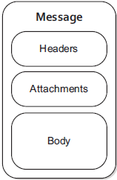
Camel message, continued
The Camel message has a body (also called a payload) where the content of the message is stored
The headers are variables attached to the message, stored as key/value pairs
The message can also embed
attachments of any type

Slide 7
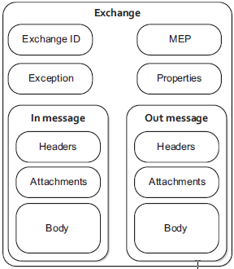
Camel exchange
The exchange is a superior entity, as it contains one or two messages
Because the message is one- way only, the exchange can hold an In message and an Out message, handling bidirectional communication

Slide 8
Camel Exchange, continued
The unique exchange ID is generated by the routing engine
The properties are variables attached to the exchange, stored as key/value pairs
The Exception area stores any error or exception message that the exchange might run into while being routed

Slide 9
Camel Exchange, continued
MEP stands for message exchange pattern; this value defines the number of messages in the exchange
By default, an exchange has only an In message and the MEP is set to “In Only”
If bidirectional communication is needed, the MEP can be changed to “In Out,” which automatically creates an Out message

Slide 10
Message headers and exchange properties
Message headers and exchange properties are variables stored as key/value pairs
Depending on the components you use, Camel automatically creates header or property variables to describe your message
For instance, when using a File component, Camel writes header variables such as CamelFileName, CamelFilePath, and CamelFileLenght
Message headers and exchange properties added by Camel are described in the documentation for each component

Slide 11
Message headers and exchange properties
You can also add or modify your own message headers and exchange properties
By using the dedicated Talend components
cSetHeader or cSetProperty
By accessing the message or exchange via Java code

Slide 12
SIMPLE language
The SIMPLE language is used to easily access exchange and message elements
The SIMPLE language uses ${expression} placeholders for complex expressions that contain constants and literals
When run into, a SIMPLE language expression is evaluated and executed on the current message/ exchange in the route

Slide 13

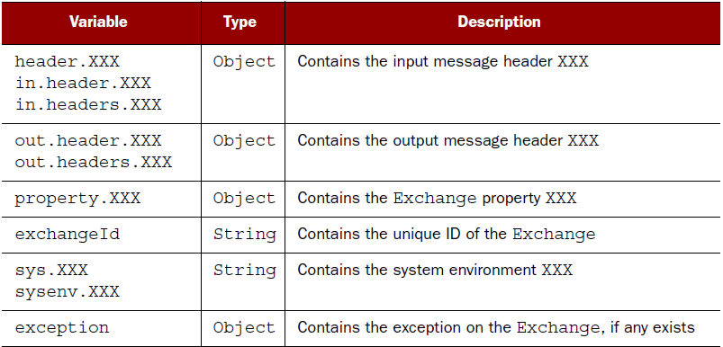
SIMPLE language, continued
Using the SIMPLE language, you can access the following variables
References : https://camel.apache.org/simple.html

Slide 14
SIMPLE language examples
To access the body of your In message:
${in.body}
To access a header variable called fileName in the In message:
${in.header.fileName}
To access a property variable called correlationID:
${property.correlationID}

Slide 15
SIMPLE language, continued
The SIMPLE language also offers basic operators and functions
The complete list is available on the Apache Camel website, along with documentation and examples

Slide 16
Lab overview
Lab 2–Logging / Lab 3–Setting body and headers
In these labs, you will:
Use the cLog component
Write a custom log message by using SIMPLE language expressions
Set a custom body and custom headers

Slide 17
Lesson summary
ESB routes transport messages stored in exchanges
The core of the message is stored in the message body
Headers and properties store additional valuable information
Message and exchange information can be accessed via SIMPLE language instructions or Java code

Slide 18
Talend ESB Basics
Message Processing with Java Beans

Slide 19
Accessing a message with Java
The current Java instance of an exchange in a route is called an exchange
By invoking the exchange instance, you can access its properties, exception messages, and in/out messages
To access the in message and read the body/write in the body
o exchange.getIn().getBody();
o exchange.getIn().setBody("Hello World!", String.class);
Access a header
o exchange.getIn().getHeader("myHeader");

Slide 20
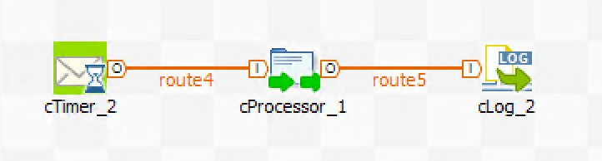
Using Java to process a message, continued
If you need to run a few lines of Java to process a message, you can use the cProcessor component
Java instructions are run each time a message passes through the component

Slide 21
Using Java beans
Java beans are simple Java classes you can call inside a route to process your exchange or message
Create a Java bean:
When you need to run a more complex block of code
When you need to create a reusable method

Slide 22
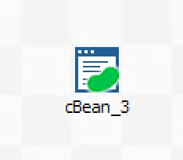
Using Java beans, continued
In the code of a Java bean, it is very easy to pass the exchange, or even some message elements, as parameters to a method
Java beans can be called by using the Talend component cBean

Slide 23
Lab overview
In this lab, you will:
Update Lab 3 to add a new route using a cProcessor
Write a Java bean to process messages
Call Java beans in two ways
Call a reference
Call a new instance

Slide 24
Talend ESB Basics
Rerouting a Message

Slide 25
Rerouting messages
In the Talend Studio, the mediation units you can create are called Camel contexts. A Camel context is a container that holds:
Components, which are used in the container
Processors and their configurations
Routes, the sequences of components and processors
Beans, the classes used in the container
When the operations team deploys an ESB build, the package it sends to the runtime is the Camel Context

Slide 26
Rerouting within the same context
A Camel context can have several routes
We recommended keeping routes short enough to be easily isolated and tested
Some routes can be accessed by multiple other routes so that their processes can be shared
In the same Camel context, routes must be able to send their messages to other routes to continue processing

Slide 27
Rerouting within the same context, continued
The Camel direct component is used to reroute a message
When used as a consumer, the direct component is given a unique URI for its context. The URI is built as follows:
direct:something
o direct is the mandatory scheme of the URI
o something is the unique name of the direct component
Once the consumer endpoint is configured, it consumes any message sent to this URI

Slide 28
Rerouting within the same context, continued
When used as a producer, the direct component is configured with the URI to which it must send the message
Any message reaching the producer direct component is produced (sent) to the URI

Slide 29

Rerouting within the same context, continued
When a message arrives at the end of Route 1, the cDirect component produces (sends) the message to the direct:something URI
direct:something
cDirect
cDirect
produces on
consumes from
Route 1
Route 2
Producer component
Consumer component

Slide 30
Rerouting within the same context, continued
As soon as the message is produced on the URI, the cDirect component from Route 2 sees this as an event and consumes it
direct:something
cDirect
cDirect
produces on
consumes from
Route 1
Route 2
Producer component
Consumer component

Slide 31
Rerouting to different Camel contexts
The direct component (cDirect in the Studio) allows rerouting only within the same context
If you need to reroute a message to a different Camel context, you can use:
The cDirectVM component—same as the cDirect component but can reach outside its own context
The SEDA component—sends to a destination outside its context, asynchronous behavior and queuing ability
A message broker—more reliable, makes sure the message is distributed and allows both point-to-point messaging and broadcast

Slide 32
Lab overview
In this lab, you will reroute a message using the cDirect component

Slide 33
Thank You

